Slide 1
Oscillatory Motion

Slide 2
Part 2 – Oscillations
Periodic motion is the repeating motion of an object in which it continues to return to a given position after a fixed time interval.
The repetitive movements are called oscillations.
A special case of periodic motion called simple harmonic motion will be the focus.
  Simple harmonic motion also forms the basis for understanding mechanical waves.
Oscillations and waves also explain many other phenomena.
  Oscillations of bridges and skyscrapers
  Radio and television
  Understanding atomic theory

Slide 3
Periodic Motion
Periodic motion is motion of an object that regularly returns to a given position after a fixed time interval.
A special kind of periodic motion occurs in mechanical systems when the force acting on the object is proportional to the position of the object relative to some equilibrium position.
  If the force is always directed toward the equilibrium position, the motion is called simple harmonic motion.

Slide 4
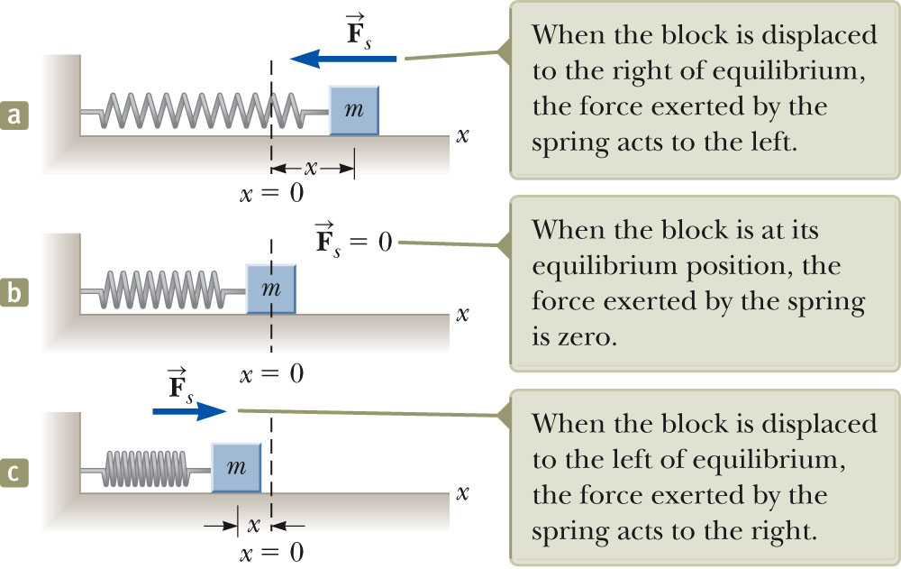
Motion of a Spring-Mass System
A block of mass m is attached to a spring, the block is free to move on a frictionless horizontal surface.
When the spring is neither stretched nor compressed, the block is at the equilibrium position.
  x = 0
Such a system will oscillate back and forth if disturbed from its equilibrium position.

Slide 5
Hooke’s Law
Hooke’s Law states that
F_{s} = - kx
  F_{s} is the restoring force.
    It is always directed toward the equilibrium position.
    Therefore, it is always opposite the displacement from equilibrium.
  k is the force (spring) constant.
  x is the displacement.

Slide 6
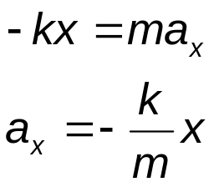
Acceleration
When the block is displaced from the equilibrium point and released, it is a particle under a net force and therefore has an acceleration.
The force described by Hooke’s Law is the net force in Newton’s Second Law.
The acceleration is proportional to the displacement of the block.
The direction of the acceleration is opposite the direction of the displacement from equilibrium.
An object moves with simple harmonic motion whenever its acceleration is proportional to its displacement and is oppositely directed to the displacement from equilibrium.

Slide 7
Motion of the Block
The block continues to oscillate between –A and +A.
  These are turning points of the motion, known as the amplitude of oscillation.
  Amplitude of oscillation-maximum displacement from equilibrium position
The force is conservative.
In the absence of friction, the motion will continue forever.
  Real systems are generally subject to friction, so they do not actually oscillate forever.

Slide 8
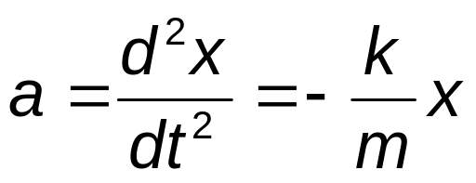
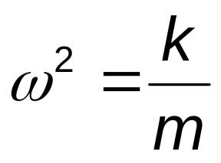
Analysis Model: A Particle in Simple Harmonic Motion
Model the block as a particle.
  The representation will be particle in simple harmonic motion model.
Choose x as the axis along which the oscillation occurs.
Acceleration
We let
Then
a = -ω²x

Slide 9
A Particle in Simple Harmonic Motion, 2
A function that satisfies the equation is needed.
  Need a function x(t) whose second derivative is the same as the original function with a negative sign and multiplied by ω^{2.}
  The sine and cosine functions meet these requirements.

Slide 10
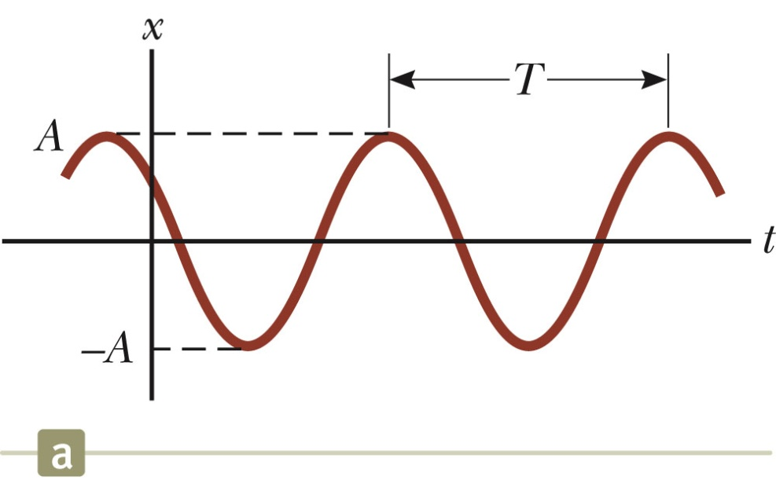
Simple Harmonic Motion – Graphical Representation
A solution is x(t) = A cos (ω t + φ)
A, ω, φ are all constants
A cosine curve can be used to give physical significance to these constants.

Slide 11
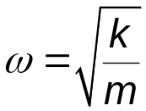
Simple Harmonic Motion – Definitions
A is the amplitude of the motion.
  This is the maximum position of the particle in either the positive or negative x direction.
ω is called the angular frequency.
  Units are rad/s
φ is the phase constant or the initial phase angle.

Slide 12
Simple Harmonic Motion, cont.
A and φ are determined uniquely by the position and velocity of the particle at t = 0.
  If the particle is at x = A at t = 0, then φ = 0
The phase of the motion is the quantity (ωt + φ).
x (t) is periodic and its value is the same each time ωt increases by 2π radians.
Note the difference between initial phase and phase
Phase = (ω t + φ)
Ιnitial phase /phase difference = φ

Slide 13
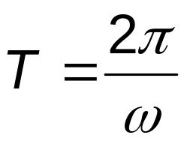
Period
The period, T, of the motion is the time interval required for the particle to go through one full cycle of its motion.
  The values of x and v for the particle at time t equal the values of x and v at t + T.
Unit of T: s

Slide 14
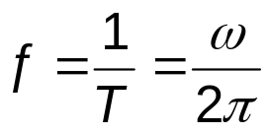
Frequency
The inverse of the period is called the frequency.
The frequency represents the number of oscillations that the particle undergoes per unit time interval.
Units are cycles per second = hertz (Hz).

Slide 15
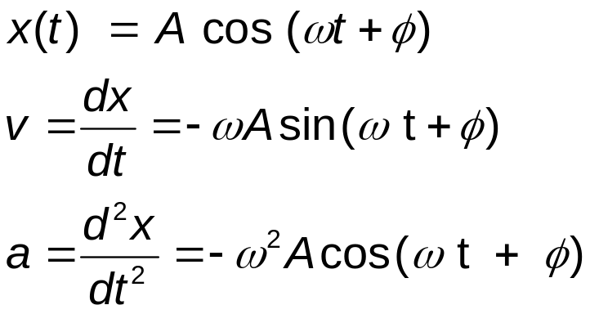
Motion Equations for Simple Harmonic Motion
Simple harmonic motion is one-dimensional and so directions can be denoted by + or - sign.
Remember, simple harmonic motion is not uniformly accelerated motion.

Slide 16
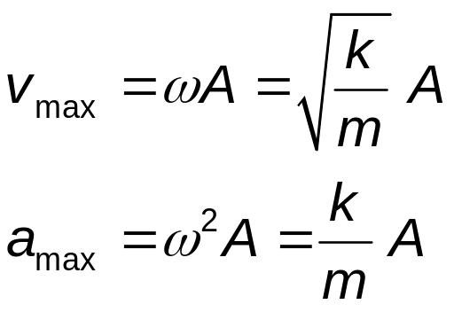
Maximum Values of v and a
Because the sine and cosine functions oscillate between ±1, we can easily find the maximum values of velocity and acceleration for an object in SHM.

Slide 17
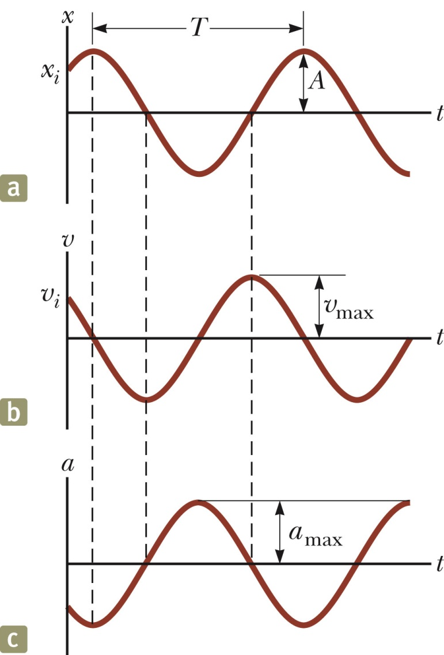
Graphical Representations of x, v and a
The graphs show:
  (a) displacement as a function of time
  (b) velocity as a function of time
  (c ) acceleration as a function of time
The velocity is 90º out of phase with the displacement and the acceleration is 180º out of phase with the displacement.

Slide 18
Energy of the SHM Oscillator
Mechanical energy is associated with a system in which a particle undergoes simple harmonic motion.
  For example, assume a spring-mass system is moving on a frictionless surface.
Because the surface is frictionless, the system is isolated.
  This tells us the total energy is constant.
The kinetic energy can be found by
  K = ½ mv ² = ½ mω² A² sin² (ωt + φ)
    Assume a massless spring, so the mass is the mass of the block.
The elastic potential energy can be found by
  U = ½ kx ² = ½ kA² cos² (ωt + φ)
The total energy is E = K + U = ½ kA ²

Slide 19
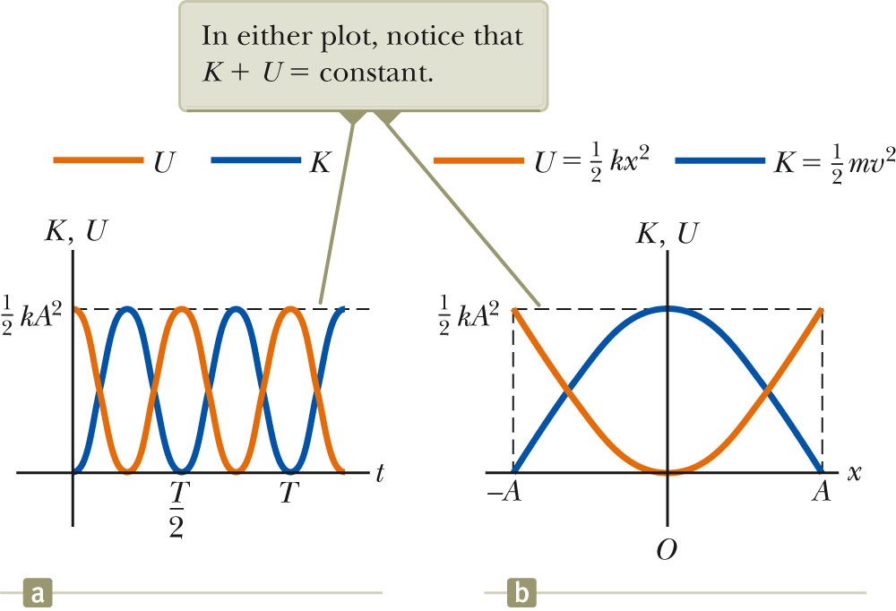
Energy of the SHM Oscillator, cont.
The total mechanical energy is constant.
  At all times, the total energy is
  ½ k A²
The total mechanical energy is proportional to the square of the amplitude.
Energy is continuously being transferred between potential energy stored in the spring and the kinetic energy of the block.
In the diagram, Φ = 0
.

Slide 20
Energy of the SHM Oscillator, final
Variations of K and U can also be observed with respect to position.
The energy is continually being transformed between potential energy stored in the spring and the kinetic energy of the block.
The total energy remains the same

Slide 21
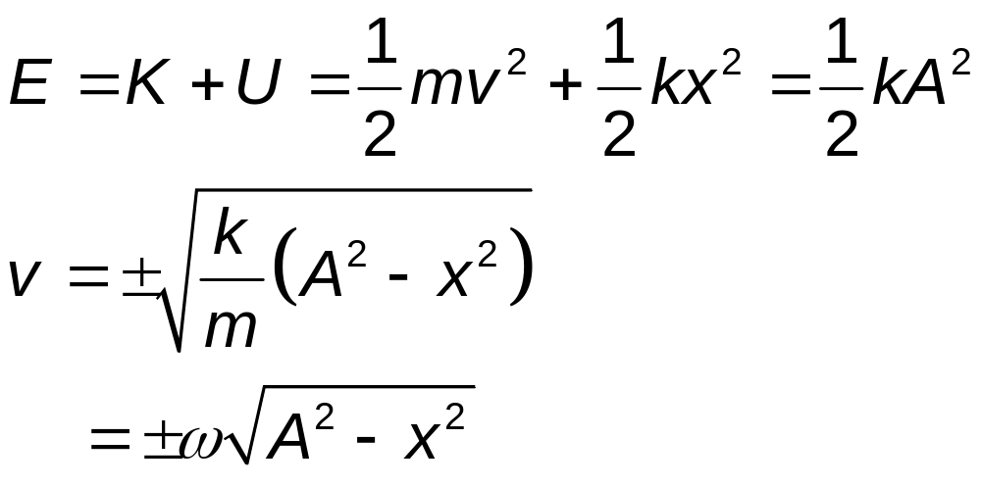
Velocity at a Given Position
Energy can be used to find the velocity:

Slide 22
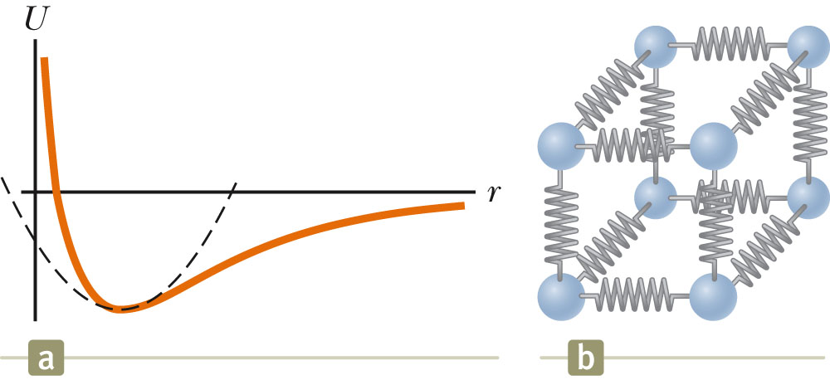
Importance of Simple Harmonic Oscillators
Simple harmonic oscillators are good models of a wide variety of physical phenomena.
Molecular example
  If the atoms in the molecule do not move too far, the forces between them can be modeled as if there were springs between the atoms.
  The potential energy acts similar to that of the SHM oscillator.

Slide 23
Simple Pendulum
A simple pendulum also exhibits periodic motion.
It consists of a particle-like bob of mass m suspended by a light string of length L.
The motion occurs in the vertical plane and is driven by gravitational force.
The motion is very close to that of the SHM oscillator.
  If the angle is <10º

Slide 24
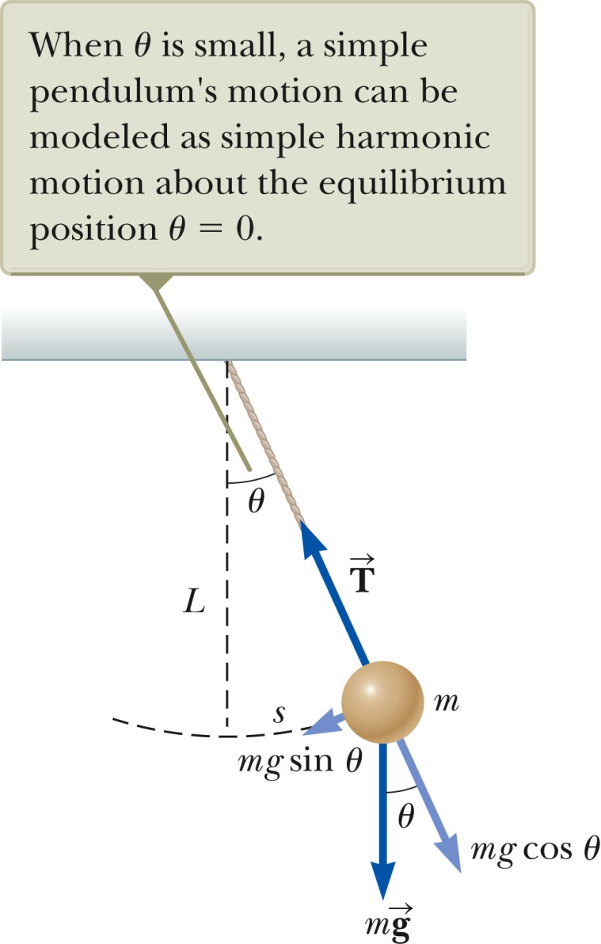


Simple Pendulum, 2
The forces acting on the bob are the tension and the weight.
  is the force exerted on the bob by the string.
  is the gravitational force.
The tangential component of the gravitational force is a restoring force.

Slide 25
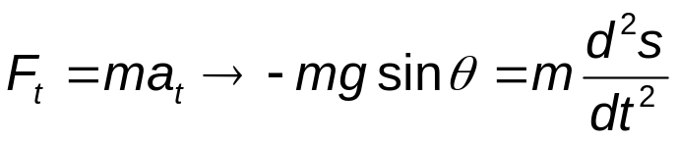
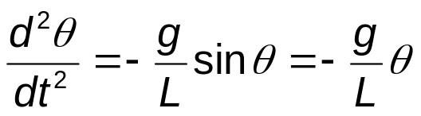
Simple Pendulum, 3
In the tangential direction,
The length, L, of the pendulum is constant, and for small values of θ.
This confirms the mathematical form of the motion is the same as for SHM.

Slide 26
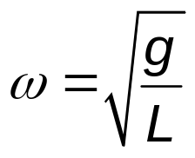
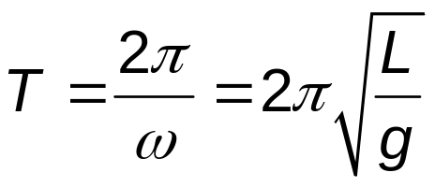
Simple Pendulum, 4
The function θ can be written as θ = θ_{max} cos (ωt + φ).
The angular frequency is
The period is

Slide 27
Simple Pendulum, Summary
The period and frequency of a simple pendulum depend only on the length of the string and the acceleration due to gravity.
The period is independent of the mass.
All simple pendula that are of equal length and are at the same location oscillate with the same period.

Slide 28
Problem 1
A body of mass 5.0 kg is suspended by a spring which stretches 10 cm
when the mass is attached. It is then displaced downward an additional
5.0 cm and released. Express its position as a function of time.

